Slide 1


Building blocks for aggregate programming of self-organising applications
Jacob Beal, Mirko Viroli
FoCAS Workshop
8th IEEE SASO
September, 2014

Slide 2
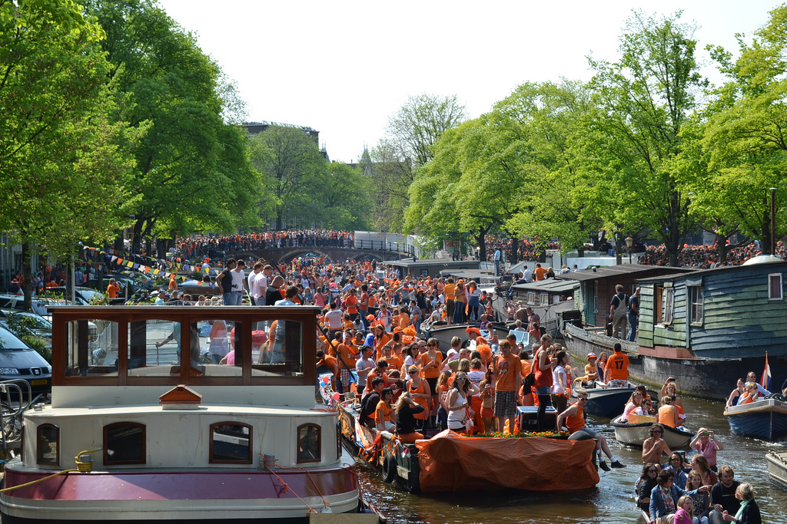
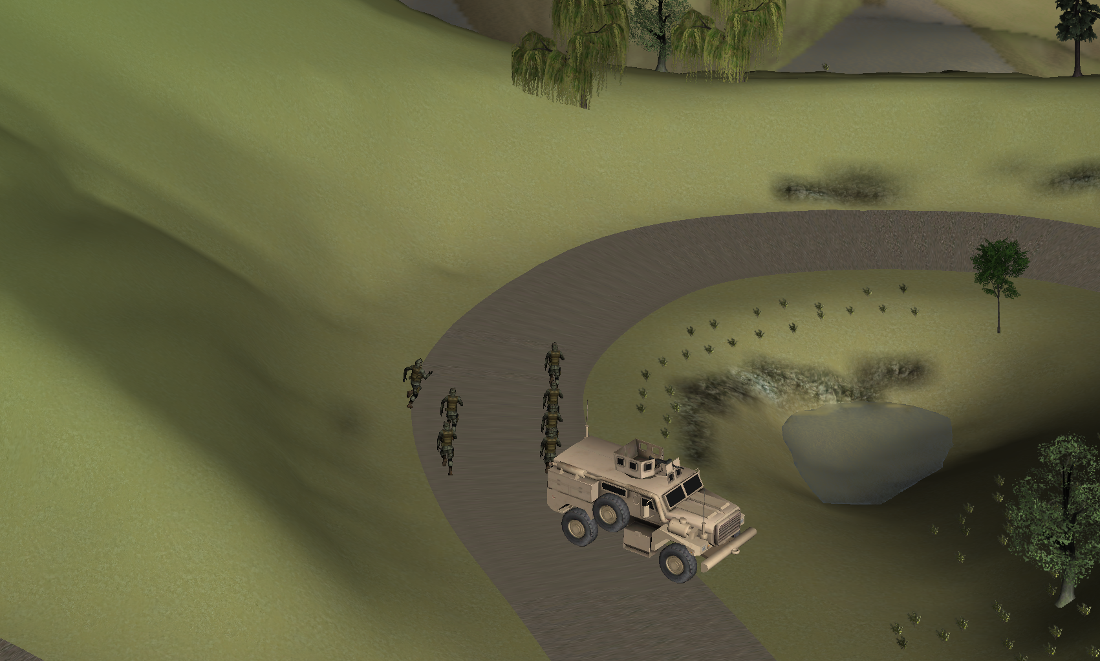
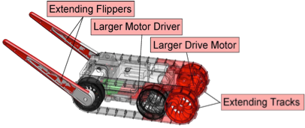
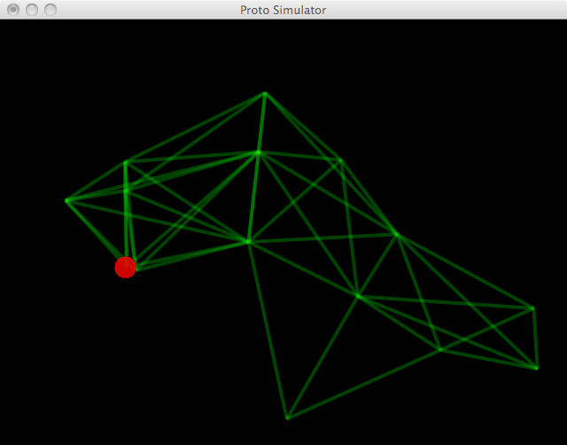
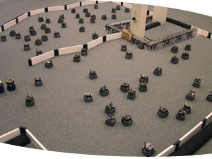
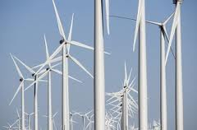
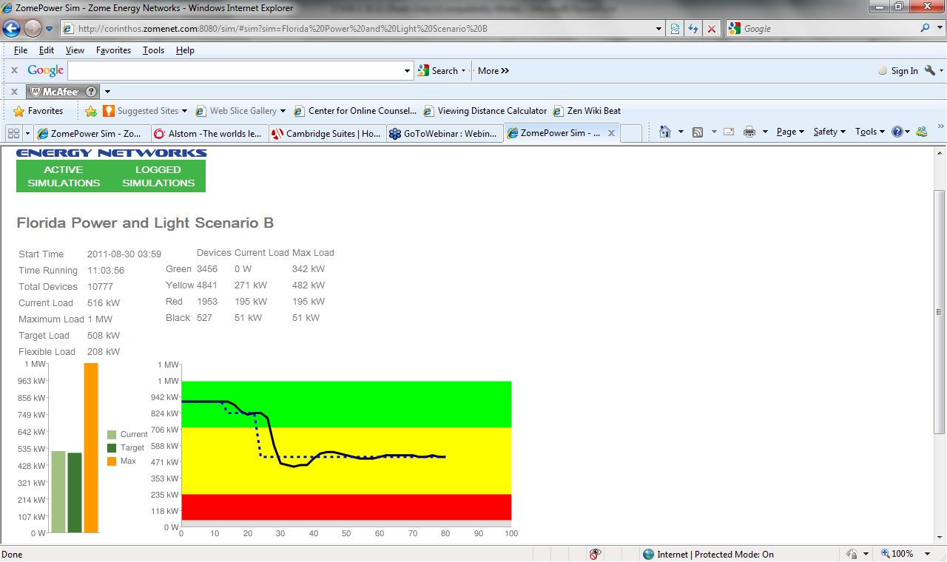
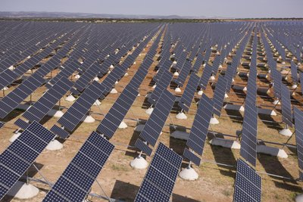
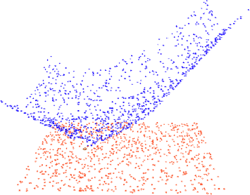
Goal: Reliable Distributed Adaptive Systems
device
neighborhood
Field-based
Computing Models
Self-Organization
Building Blocks
Lots of distributed applications!

Slide 3
Example: Services for Mass Events

Slide 4
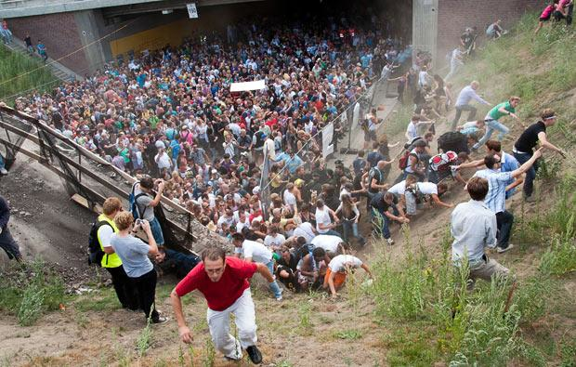
Example: Managing Crowd Danger
Notes:
Love Parade disaster: electronic music festival in Duisberg, Germany in 2010. Many more people came then expected (possibly as many as 1.4 million to an old freight stations holding a max of 250K), and a mass panic caused 21 deaths and 510 injuries.

Slide 5
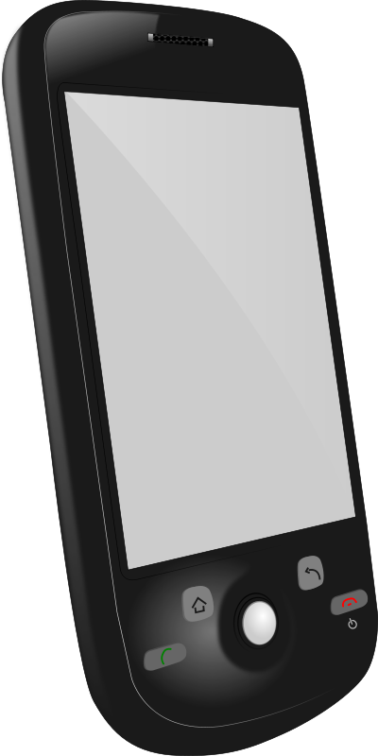
Device-Centric Programming
Dispersal Advice
Congestion-Aware Navigation
Dangerous Density Warning
Crowd Estimation
Explicit design of adaptation and communication
Complex per-device multi-service application
Intractable to ensure correct behavior

Slide 6
Aggregate Programming
Dispersal Advice
Congestion-Aware Navigation
Dangerous Density Warning
Crowd Estimation
Implicit adaptation and communication
Code each service independently
Compose via scope and information flow

Slide 7
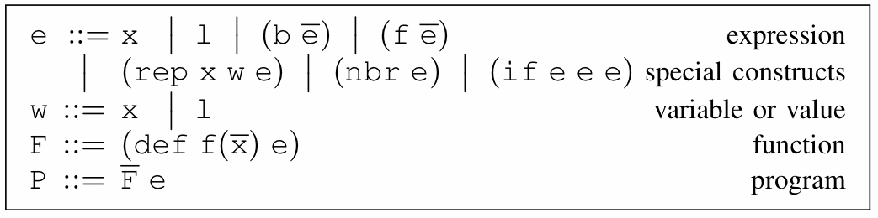
Foundation: Field Calculus
State
Variable
Literal Value
Local Ops
Communication
Domain Change
Abstract & Call
Functions
Aggregate/local coherence, space-time universal
Too low level, no adaptivity guarantees
[Viroli et al., ’13]

Slide 8
From Principle to Practice:
Transparent use of
robust distributed algorithms
Applications
unlimited uses
Programmer level: lots of
useful, intuitive methods
Domain-specific APIs
Distributed Library APIs
many algorithms
Provable robustness,
scalability, composability
Building blocks
5-20 combinators
Provable universality,
aggregate/local relation
Core Calculus
5 operators

Slide 9
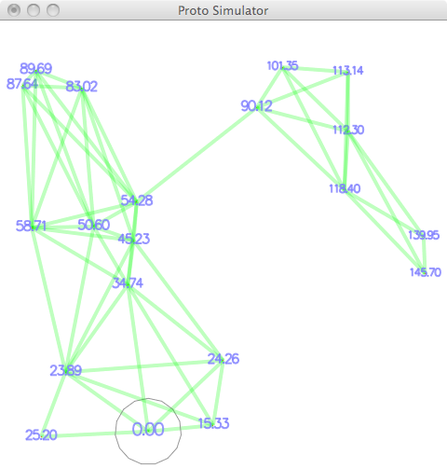
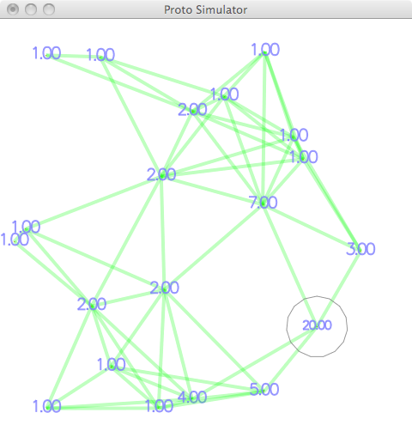
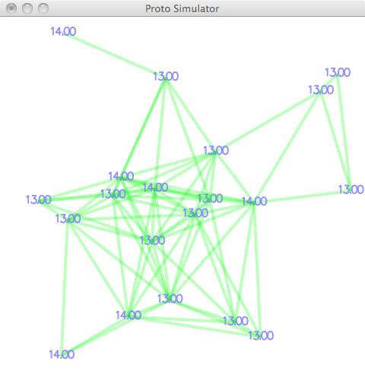
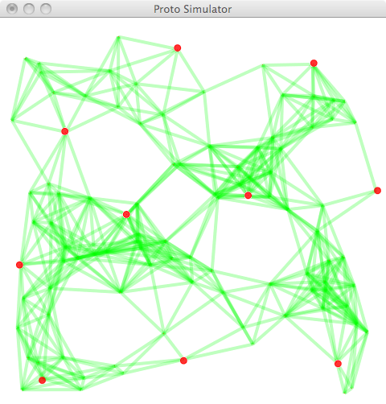
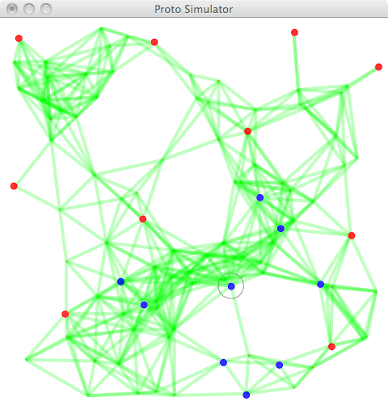
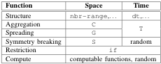
Making a library of building blocks:
All compositions are self-stabilizing
Time-decay
Converge-cast
Gradient-path-integral
Sparse-choice
if

Slide 10
Building Block: G
Information spreading
Field Calculus Implementation:
(def G (source initial metric accumulate)
(2nd
(rep distance-value
(tuple infinity initial)
(mux source (tuple 0 initial)
(min-hood
(tuple
(+ (1st (nbr distance-value)) (metric))
(accumulate (2nd (nbr distance-value)))))))))
Library Examples:
(def distance-to (source)
(G source 0 nbr-range (fun (v) (+ v (nbr-range)))))
￼
(def broadcast (source value)
(G source value nbr-range identity))

Slide 11
Building Block: C
Information collection
Field Calculus Implementation:
(def C (potential accumulate local null)
(rep v local
(accumulate local
(accumulate-hood accumulate
(mux (= (nbr (find-parent potential)) (uid))
(nbr v) null)))))
(def find-parent (potential)
(mux (< (1st (min-hood (nbr potential))) potential)
(2nd (min-hood (nbr (tuple potential (uid)))))
NaN))
Library Examples:
(def summarize (sink accumulate local null)
(broadcast sink
(C (distance-to sink) accumulate local null)))
￼
(def average (sink value)
(/ (summarize sink + value 0)
(summarize sink + 1 0)))￼

Slide 12
Building Block: T
Time-summarization of information
Field Calculus Implementation:
(def T (initial decay)
(rep v initial
(min initial
(max 0 (decay v)))))
4
3
1
7
1
3
3
0
2
Library Examples:
(def timer (length)
(T length (fun (t) (- t (dt)))))
(def limited-memory (value timeout)
(2nd (T (tuple timeout value)
(fun (t) (tuple (- (1st t) (dt)) (2nd t))))))

Slide 13
Building Block: S
Choice of sparse subset
Field Calculus Implementation:
(def S (grain metric)
(break-using-uids (random-uid) grain metric))
(def random-uid ()
(rep v (tuple (rnd 0 1) (uid))
(tuple (1st v) (uid))))
(def break-using-uids (uid grain metric)
(= uid
(rep lead uid
(distance-competition
(G (= uid lead) 0 metric
(fun (v) (+ v (metric))))
lead uid grain metric))))
(def distance-competition (d lead uid grain metric)
(mux (> d grain) uid
(mux (>= d (* 0.5 grain)) infinity
(min-hood
(mux (>= (+ (nbr d) (metric)) (* 0.5 grain))
infinity
(nbr lead))))))

Slide 14
Building Block: if
Restrict scope to subspaces
Field Calculus Implementation:
(if test
true-expression
false-expression)
Library Examples:
(def distance-avoiding-obstacles (source obstacles)
(if obstacles
infinity
(distance-to source)))
(def recent-event (event timeout)
(if event true (> (timer timeout) 0)))￼

Slide 15
Applying building blocks:
Example API algorithms from building blocks:
distance-to (source) max-likelihood (source p)
broadcast (source value) path-forecast (source obstacle)
summarize (sink accumulate local null) average (sink value)
integral (sink value) region-max (sink value)
timer (length) limited-memory (value timeout)
random-voronoi (grain metric) group-size (region)
broadcast-region (region source value) recent-event (event timeout)
distance-avoiding-obstacles (source obstacles)
Since based on these 5 building blocks, all programs built this way are self-stabilizing!

Slide 16
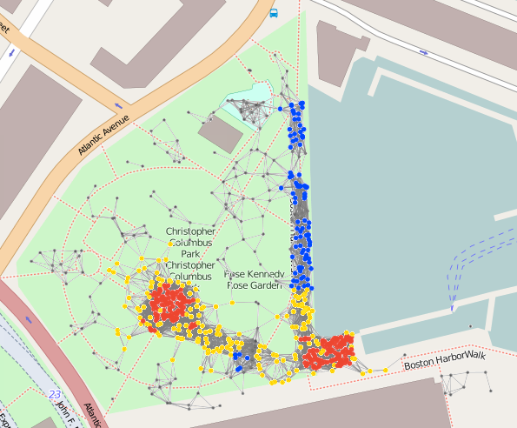
Complex Example: Crowd Management
(def crowd-tracking (p)
;; Consider only Fruin LoS E or F within last minute
(if (recently-true (> (density-est p) 1.08) 60)
;; Use S to break into ‘‘cells’’ and estimate danger of each
(+ 1 (dangerous-density (S 30) p))
0))
(def recently-true (state memory-time)
;; Make sure first state is false, not true...
(rt-sub (not (T 1 1)) state memory-time))
(def rt-sub (started s m)
(if state 1 (limited-memory s m)))
(def dangerous-density (partition p)
;; Only dangerous if above critical density threshold...
(and
(> (average partition (density-est p)) 2.17)
;; ... and also involving many people.
(> (summarize partition + (/ 1 p) 0) 300)))
(def crowd-warning (p range)
(> (distance-to (= (crowd-tracking p) 2))
range)
(def safe-navigation (destination p)
(distance-avoiding-obstacles
destination (crowd-warning p)))
18 lines non-whitespace code
10 library calls (18 ops)
IF: 3 G: 9 C: 3 T: 2 S: 1

Slide 17
Contributions
Composable algebra of building block algorithms
Terse enough to prove universal self-stabilization
Applicable to a broad range of adaptive distributed systems
Lots of details in our tutorial this afternoon!

